Slide 1
CASE STUDY 3
Forecasting Adoption of Telepresence Robot Technology
By Group 2: Evan Duran, Thanvitha K, Jeevan Gowda, Nanditha K, Adrian Vasquez, Vamsi

Slide 2
BACKGROUND
The mission statement of CEO Satya Nadella is: "To enable every individual and every organization on the globe to attain greater success."
Strategy: Mobile-First, Cloud-First
Mobile-first: Focus on mobility of experiences and devices.
Cloud-first: Emphasizing the power and flexibility of cloud technologies.

Slide 3
Key Move: LinkedIn Acquisition (2016)
Amount: $26.2 billion, Microsoft's largest acquisition.
Purpose: Strengthening the new vision and strategy.
Nadella's Vision:
Empowering individuals and organizations globally.
Harnessing technology for greater success.

Slide 4
Cisco's iRobot Ava 500 Acquisition:
Sparked interest among Microsoft executives in robotic telepresence technology for business applications.
Watch and Wait" Strategy:
Learn from experiences of companies like Cisco.
Quick response readiness if the technology gains traction.
"Lead the World" Strategy:
Actively participate in technology advancement.
Collaborate closely with lead users to shape and market telepresence robot technology.

Slide 5
The company decided to undertake a forecasting analysis of mobile robotic telepresence technology (MRTT).
To further its corporate mission, the company hoped that this kind of analysis would offer guidance when determining whether to make significant investments and/or acquisitions related to this technology.

Slide 6
INTRODUCTION
MRTT, (Mobile Robotic Telepresence Technology) which combines telepresence and teleoperation, allows semi-autonomous robots to be operated remotely.
The local environment is where the robot is located, and those who are in its presence are referred to as local users.
The robot is controlled by a remote user. Through telepresence, a remote user can virtually attend a distant event (like a meeting) without physically being there.
An RTU either has a screen built in or can be connected to separate screen devices (like a tablet or phone), depending on the manufacturer and product version.

Slide 7
RTU’s
Apart from being able to walk, RTUs also have a wireless transmitter, video camera, and microphone for online communication.
The use of robotic telepresence in the workplace has the potential to
reduce travel,
provide instant access to others,
save money on business expenses
fosters collaboration that is comparable to in-person interaction something that is not possible with a smartphone or tablet by itself.
Notes:
Apart from being able to walk, the device also has a wireless transmitter, video camera, and microphone for online communication.
The use of robotic telepresence in the workplace has the potential to reduce travel, provide instant access to others, save money on business expenses, and perhaps most importantly recent research indicates that it fosters collaboration that is comparable to in-person interaction something that is not possible with a smartphone or tablet by itself.

Slide 8
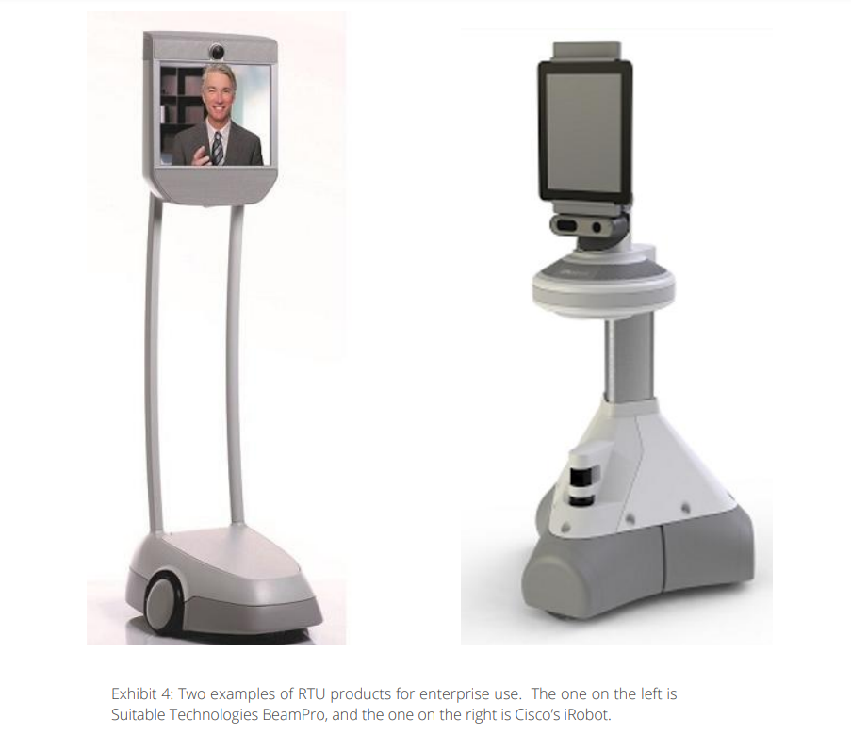
Examples of RTUs in the market

Slide 9
WHAT IS THE BASS MODEL?
The Bass model was originated by marketing professor Frank Bass. It is used to predict new product diffusion patterns.
a mathematical model to predict new product adoption patterns adopted in a market.
There are two key parameters in the Bass model - usually called p, and q.

Slide 10
The parameters p and q determine the shape of the adoption curve.
§ The parameter p is called the coefficient of innovation and represents the rate or probability that an innovator will adopt at time t. (or coefficient of external influence)
§ The parameter q is called the coefficient of imitation and accounts for the “word of mouth” or “social contagion” effects. or coefficient of internal influence).

Slide 11
PESSIMISTIC SCENARIO
Objective: Explore potential challenges in the market performance of Remote Telepresence Robots (RTUs).
Political, Environmental and Market Challenges:
Stricter political laws and export restrictions.
Environmental concerns impacting production costs.
Saturated market with limited innovation.

Slide 12
Economic Impact:
Financial challenges affecting business investments.
Budget cuts leading to reduced acceptance rates.
Bass Diffusion Model:
Innovation Coefficient (p): Low at 0.0005.
Imitation Coefficient (q): Low at 0.25.

Slide 13
MODERATE SCENARIO
Objective: Assess a balanced outlook with moderate market growth potential.
Political, Environmental and Market Challenges:
Lowered trade barriers and supportive government policies.
Embrace of sustainability and efficient products.
Robust market with diverse RTU offerings.

Slide 14
Economic Factors:
Stable economic conditions driving adoption.
Lower travel costs and increased productivity.
Bass Diffusion Model:
Innovation Coefficient (p): Moderate at 0.0009.
Imitation Coefficient (q): Moderate at 0.018.

Slide 15
OPTIMISTIC SCENARIO
Objective: Explore a positive outlook with substantial market growth.
Political, Environmental and Market Challenges:
Global investments and cooperation.
Green manufacturing and environmental leadership.
Adoption across various industries.

Slide 16
Economic Impact:
Thriving global economy driving RTU market.
Cost savings and increased productivity.
Bass Diffusion Model:
Innovation Coefficient (p): High at 0.001.
Imitation Coefficient (q): High at 0.60.

Slide 17
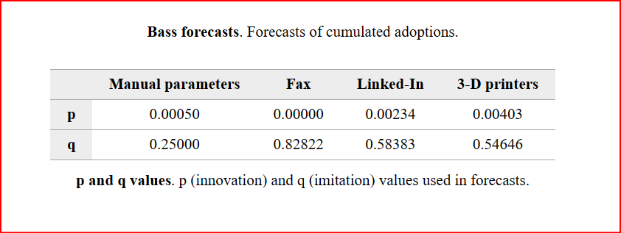
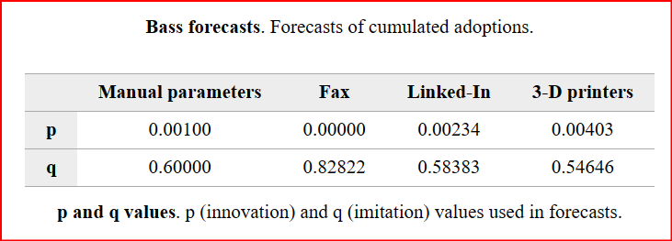
Pessimistic & Optimistic Innovation and Imitation Values
P
Q
P

Slide 18
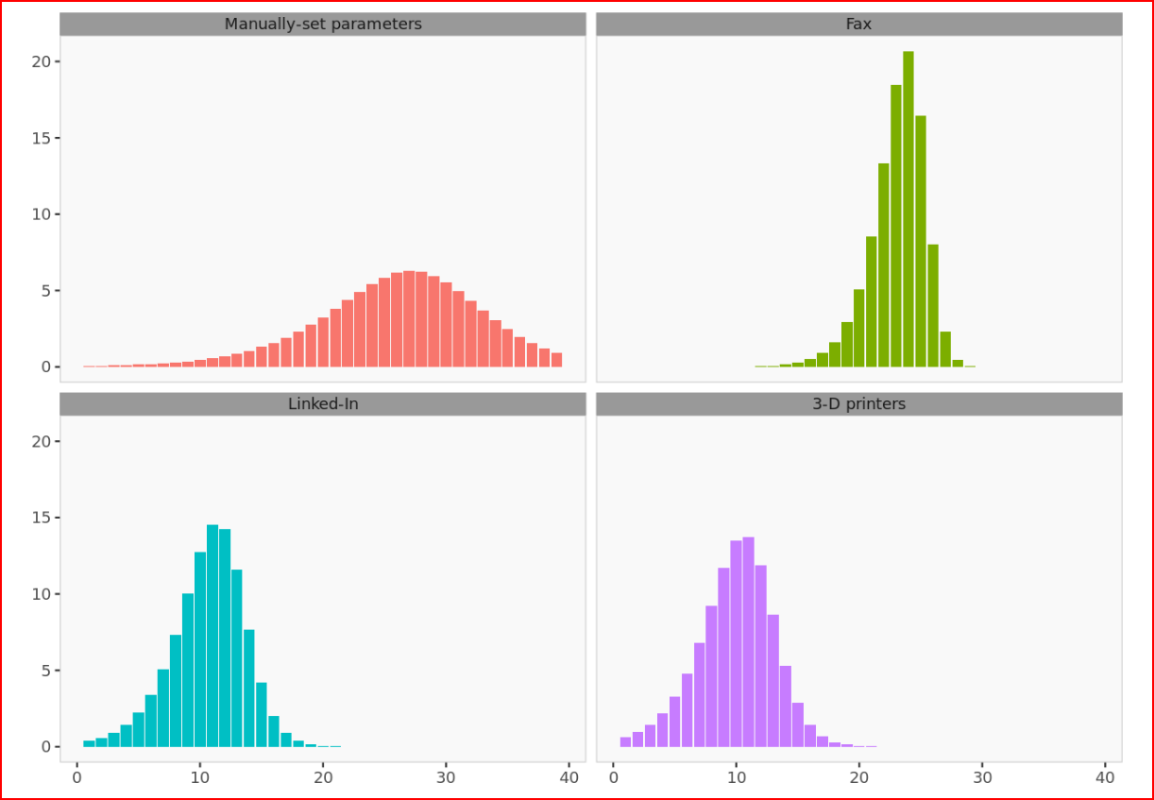
Analysis of Pessimistic Scenario:
P=.0005 Q=.25
Max adoption per period is 7% while similar products are 16%
Peak Adoption/Maturity takes 30 period while the average peak adoption takes 14.67 periods for other products.
Due to the low imation factor Growth does not increase exponentially like and maturity takes much longer then similar product.
.

Slide 19
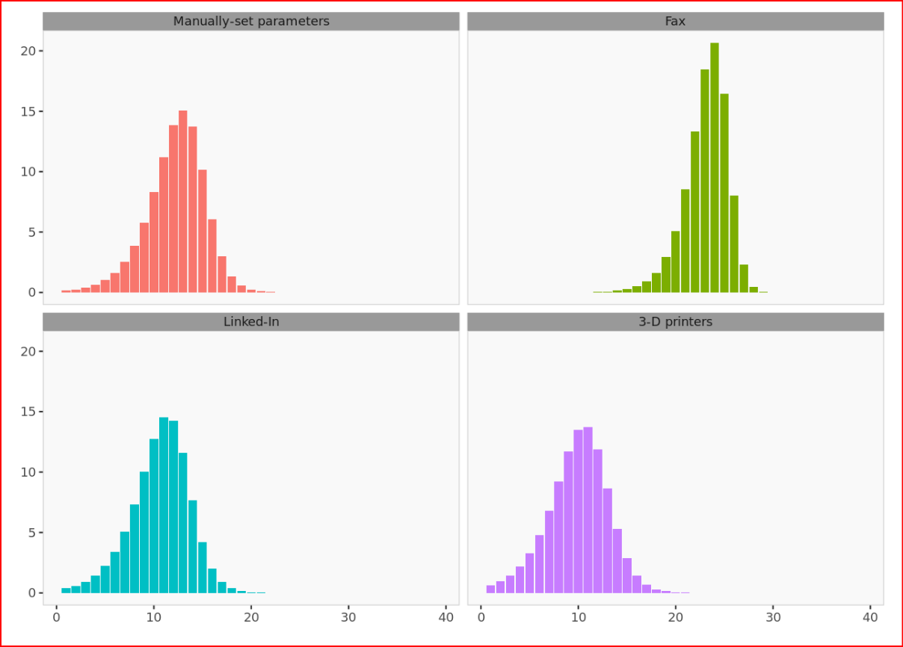
Analysis of Optimistic Scenario:
P= .001 Q=.60
When we doubled Imation Value, and effects are drastic.
Optimistic graph max adoption per period is 15 while the average of the other products is 16%.
The average time it take for similar products to mature or peak is 15 periods while the telepresence takes 12 period
Overall is similar to other product despite have little innovation value.We figure is many organization, and institution adopt this technology will trigger more imation which will improve the speed and volume of sales.
The optimistic scenario is much similar to linkdIn and 3D and our graph confirms it

Slide 20
Recommendations
Short term:
Find novel, ways to integrate the technology in places consumers already are. (Ie. within hospitals)
Demonstrate to consumers how the mobility of RTUs sets it apart from substitute products
Find ways to limit the information gap from product to consumer.

Slide 21
Recommendations
Long Term:
Focus on building a stable base of users
Create useful features which makes RTUs complexity worth the effort
Focus on building synergistic effects of multiple RTUs to aid in organizational adoption.

